Slide 1

A Method for the Shortest Path Search by Extended Dijkstra Algorithm
Group-8
S.Pavan Sai Krishna - 2022H1030061H
Soumyadip Guha - 2022H1030092H
Havisteja Dantu - 2022H1030083H

Slide 2
The path search problem involves finding the optimum path between the present location and the destination under given conditions.
This problem arrives in networks such as the highway system, railroads, and communication networks, and cover a wide range of applications. In particular, car navigation systems.
1.Introduction

Slide 3


Slide 4
A number of path search methods have been proposed for use in car navigation systems, but while all of those methods have their respective merits and demerits, no exceptionally good method has yet been established.
The three main types of algorithms that are currently being used or studied for use in path search problems are
1)A* algorithm
2)Genetic algorithm
3)Dijkstra’s algorithm

Slide 5
A* Algorithm
A* was initially designed as a graph traversal problem, to help build a robot that can find its own course. It still remains a widely popular algorithm for graph traversal.
It searches for shorter paths first, thus making it an optimal and complete algorithm. An optimal algorithm will find the least cost outcome for a problem, while a complete algorithm finds all the possible outcomes of a problem.

Slide 6
It is the sum of two variables values that determines the node it picks at any point in time.
At each step, it picks the node with the smallest value of ‘f’ (the sum of ‘g’ and ‘h’) and processes that node/cell. ‘g’ and ‘h’ is defined as simply as possible below:
‘g’ is the distance it takes to get to a certain square on the grid from the starting point, following the path we generated to get there.
‘h’ is the heuristic, which is the estimation of the distance it takes to get to the finish line from that square on the grid.

Slide 7
2.Genetic algorithm
A genetic algorithm is an adaptive heuristic search algorithm inspired by "Darwin's theory of evolution in Nature.
Basic Terminology:
Population
Chromosome
Gene
Allele
Fitness Function
Genetic operators
Selection

Slide 8
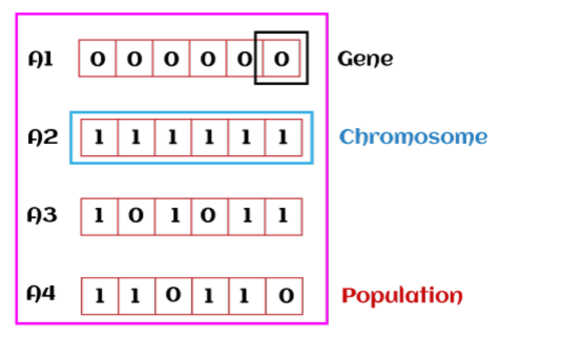

Slide 9
3.Dijkstra’s Algorithm
This is an algorithm for finding the optimum path. Because this algorithm searches for the minimum-cost path among all paths in order, beginning from the starting point, the search region expands concentrically. This method thus has the disadvantages of poor search efficiency and a long search time when the distance to the destination is large.

Slide 10
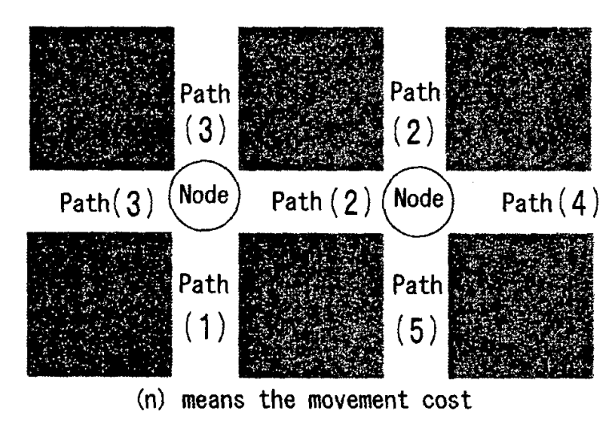
We describe the algorithm of the Dijkstra method. First, we consider road intersections as nodes, the roads that connect nodes as paths (routes), and the length and ease of transit of a path as the movement cost (cost)

Slide 11
Algorithm for Dijkstra
Step 0: Mark the starting point.
Step 1: Calculate the movement cost for movement from the starting point to each node connected to the starting point, and mark the node for which that value is the smallest.
Step 2: Calculate the movement cost for movement between the starting point and each node connected to the marked node and mark the node for which that value is the smallest.
Step 3: Repeat Step 2 until the destination is marked.

Slide 12
Extended Dijkstra’s Algorithm
In the conventional Dijkstra method, the search region generally expands concentrically.
This method has the disadvantage that the solution cannot be obtained in real time if the distance from the starting point to the destination is long.
Therefore, we propose a new algorithm in which the Dijkstra method is applied from both directions, which is to say beginning from the starting point and also beginning from the destination.
In this way, the concentric expansion of the search region is restricted and the number of nodes to be searched can be reduced.

Slide 13
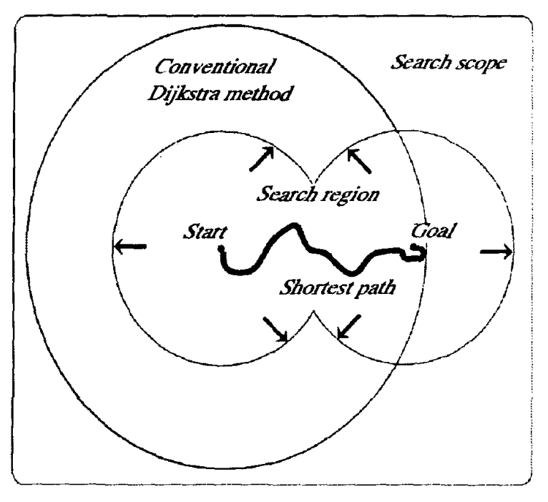

Slide 14
AIgorithm for Extended Dijkstra
Step 0: Mark the starting point and destination point.
Step 1: Calculate the movement cost for movement from the starting point to each node connected to the starting point and for movement from the destination to each node connected to the destination, and mark the nodes for which those values are the smallest.
Step 2: Mark the nodes that have the smallest movement cost from the unmarked nodes that are connected to the marked nodes to either the starting point or the destination.
Step 3: Repeat Step 2 until the search from the starting point and the search from the destination overlap and then end.

Slide 15
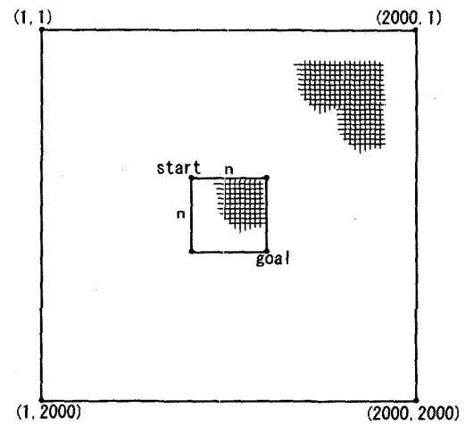
Simulation
We created a. 2000 x 2000 node grid pattern of paths to serve as the search region.
The path movement costs were assigned with a uniform random distribution in five levels, 1 to 5

Slide 16
We can change the distance between source and destination by changing the size of the square.
We performed 10 simulation for each distance of total 17 distance ranged from 10 to 450.

Slide 17
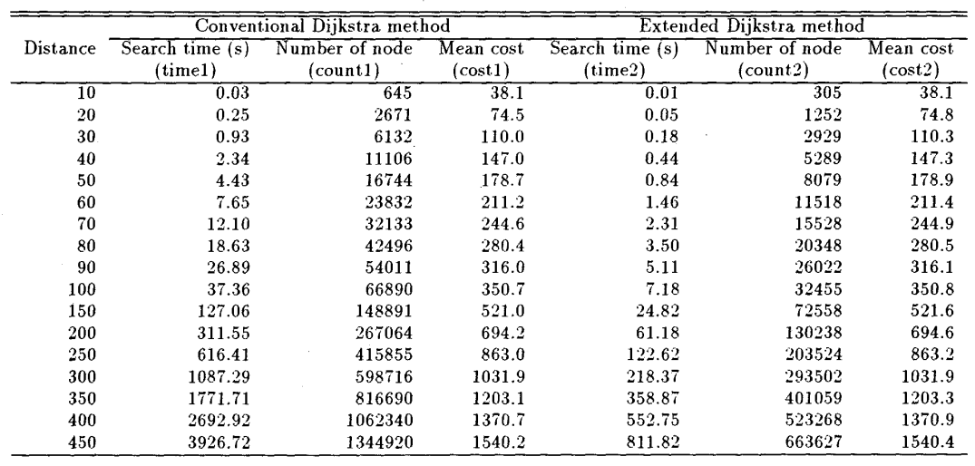
Simulation Results

Slide 18
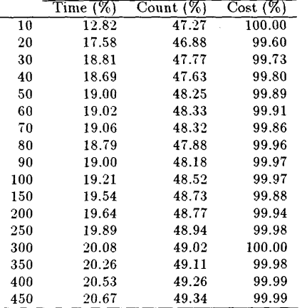

Slide 19
Observations
With the extended Dijkstra method, the number of nodes checked is reduced by about one-half compared to the conventional Dijkstra method.
By reducing the number of nodes checked, the search time was shortened to about 1/5 the original time.
The conventional and extended Dijkstra method both give the optimum solution and the minimum movement cost.
We got difference between the movement cost between two algorithm in 44 out of 250 runs, which is about 18%.

Slide 20
Conclusion
Extended Dijkstra algorithm can give near optimum solutions and its confirmed by the simulation.
The result can show that time can be greatly reduced without much impact on movement cost.
This new method can be applied in the car navigation system and other such path search problem here real-time solution required.
As this is based on Dijkstra so problem of long search time for broad search scope is remained.
In future we can optimize this algorithm further using genetics algorithm.

